Slide 1

Zoltar Stock App
Team 19 – Garett Goodale, Anton Strickland, Kyle Sizemore

Slide 2
Zoltar: A Guesser of Fortunes
This stock app brings the concept of AI-led stock trading down to an entry level. Using deep neural networks Zoltar provides traders with stock data alongside DNN statistics to drive their decision making instead of automating the process itself. (Similarly to the technology behind the Richmond Medallion Fund)
Track Stocks over time and compare them With prediction Profiles
DNN Models predict stock trends with up-to-date Accuracy Ratings
Simple and Efficient; the exact functionality you want without delay

Slide 3
Why Zoltar?
Open Sourced:
Updates come at the speed of the internet community behind the Keras library
Tkinter framework makes modding new UI elements and functionality easy for code-savvy traders who are familiar with the system
AI-Assisted, not Controlled
Zoltar is designed for the casual trader, not an investment firm with millions of trades a day.
Traders will know every investment made, no auto-bids from AI-bugs
Other Systems
8topuz – An effective cloud based algorithm which is locked to their model alone
Brokers and Bankers – Oftentimes they take a percentage of the profits as well as control

Slide 4
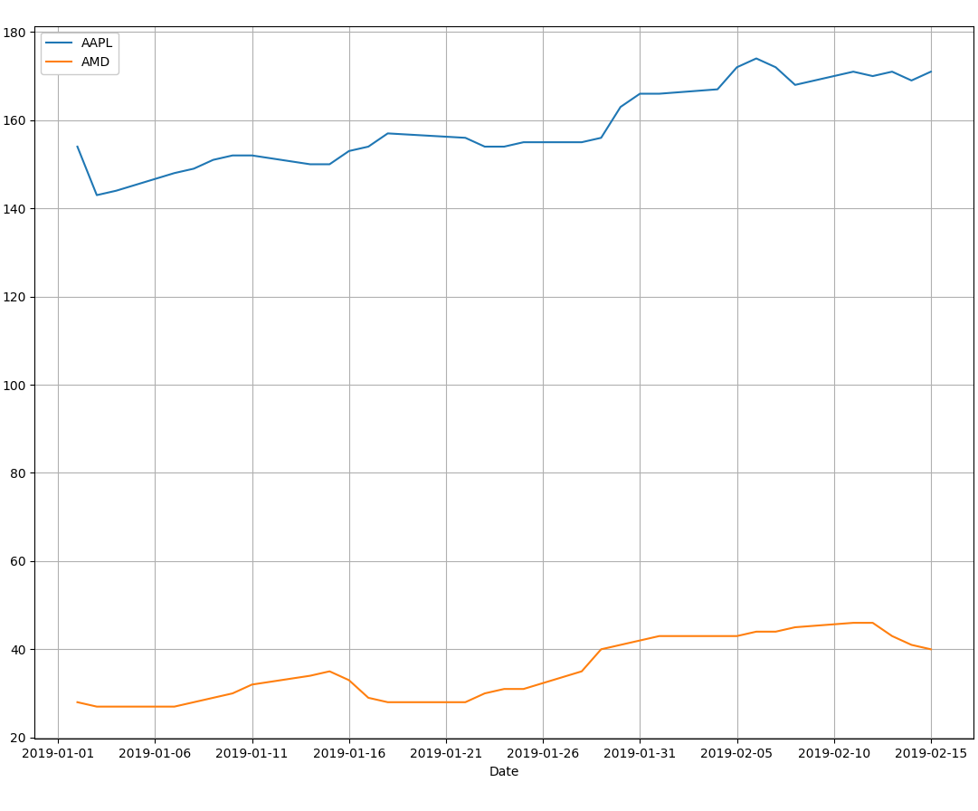
Core Features
Stock History Charts
Prediction Sets
Train and Select from Multiple DNN Models

